Slide 1
Employee Analytics Dashboard
File created on: 1/24/2024 6:28:38 PM

Slide 2
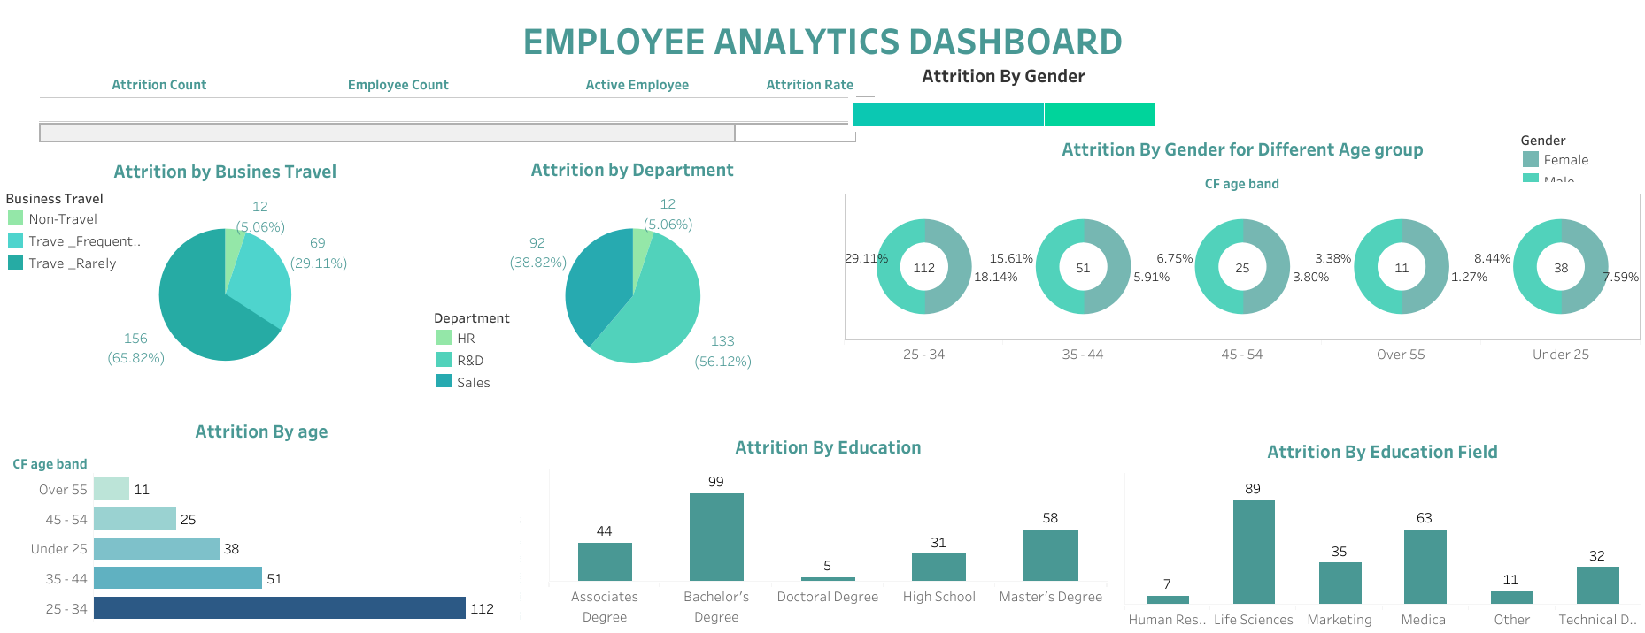

Slide 3
